Slide 1

Sales ​​Performance Improvement of ​​ Velodrive Company Using Geoanalytical ​​Methods​
Students:
Polina Abalakova
Irina Pendriak
Research advisor:
Tushkanova O.N.

Slide 2
Research Problem | 03
Research Tasks | 04
Methodology | 05
Company Overview | 06
Data Collection | 07
Velodrive Network in St.Petersburg | 08
Sales Performance Analysis | 09
Feature Selection | 10
Multiple Linear Regression | 11
Proposed Retail Sites Impact | 12
Visualization of Results | 13
Conclusion | 14
Agenda
2

Slide 3
Research Problem
Company Problem
Currently Velodrive bases the choice of a retail location only on the rental payment. They would like to take data-driven decisions to follow their sales strategy and to place their stores based on combination of several factors. ​
Research Problem
To determine the most important and publicly available geofactors for the success of the point of sale (in terms of revenue), estimate their effect on the business of the company and provide valuable insights and location opportunities to the company.
3

Slide 4
Research Tasks
Task #1 To study the existing methodology and approaches to the problem
Task #2 To collect the required and available data from the company and geodata through API
Task #3 To process and analyze the received data with the analytical instruments and tools and statistical methods
Task #4 To build a statistical model to identify the most important geofactors
Task #5 To suggest potential locations and estimate their performance based on the predictions of the model
4

Slide 5

Methodology
Step 01
Data collection Collection of financial data from the company, geodata from 2GIS API and target audience data from the DataLens Marketplace
Visualization of results Visualization of research results on dashboard via Yandex DataLens
Step 06
Step 02
Data Preprocessing Cleaning and transforming the data to a suitable format for further modelling
Estimation of business effect Creation of financial model for 5 potential locations
Step 05
Step 03
Data Analysis Analysis of the Velodrive product assortment to identify seasonal trends, best performing products and stores
Step 04
Modelling Building a multiple regression model to analyze the most influential geofactors and predict sales for new locations
5

Slide 6
Company Overview
Velodrive is a network of specialized stores selling bicycles and sports goods founded in 2005. The company is one of the largest players in the retail market in the bicycle segment.​
Products and services
Sales channels
Promotion channels
Summer season:​
Bicycles​
Bike parts and accessories​
Scooters​
Balance bikes​
Skateboards​
Winter season:​
Snowboards​
Skis​
Snow tubes​
Sledges​
Services:
Repair
Bike rental
Winter equipment rental
Seasonal storage
Own retail stores​
Online channels (website and marketplaces)​
Franchise​
Wholesale
Sales promotion campaigns
Advertising (offline and online)
Cross-promotion with other businesses
Organization of bike events
*Source: Velodrive corporate presentations based on financual statement, our analysis of sales data provided
6

Slide 7



Data Collection
We were able to collect internal data of the company on 12 retail stores, excluding the franchise network which cannot be disclosed due to NDA. Yet, the location of the whole franchise was taken into account while suggesting new sites and is reflected on the dashboard map.
Volume of sales, COGS, gross profit, rental fees, HR costs
Provided by the company
Financial data
Store coordinates, competition rate, distance to the points of interest (metro, hypermarket, Sportmaster)
Collected via requests to 2GIS API
Geodata
Audience with the interest “Cyclists” in each hexagon
Collected from Yandex DataLens Marketplace
Socio-demographic data
7

Slide 8
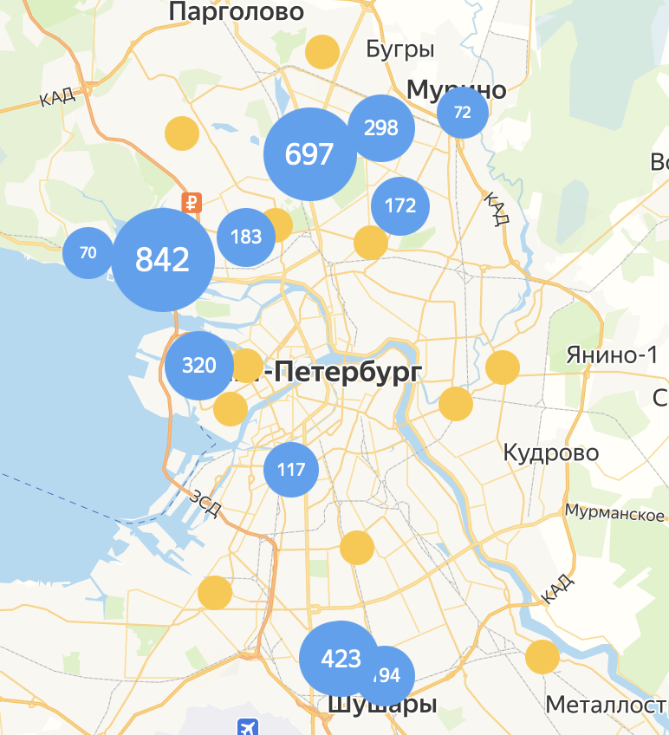
Velodrive Network in St.Petersburg
Company’s network is widespread, yet certain areas may remain underserved.
Size of the blue circles reflects the comparative area of a store in squared meters. Data for the franchise is not available.
On average, the bigger the store, the higher the sales.
Velodrive own stores
Franchise stores
8

Slide 9
Sales Performance Analysis
COVID-19 period impacted positively the company sales. The following periods were not able to achieve the COVID sales levels.
Average annual rental cost of 1 sq.m - RUB 13 850
Average annual sales level per 1 sq.m - RUB 196 300
Average gross profit margin – 40%
Profit per 1 sq.m. - RUB 65K (w/o HR costs and other OpEx).
Seasonality remains one of the key specificities of the business. Winter equipment does not compensate for the traditional categories out-of-season sales drops.
9

Slide 10
Feature Selection for Multiple Regression
Preselected features for the multiple regression*
Rental area (sq.m)
Distance to the nearest competitor store
Annual cost of
1 sq.m. rented
Competition level
Distance to the nearest metro station
Presence on the market, in months
Floor on which a store is located
Parking in the radius of 500 meters
Distance to the nearest Sportmaster
Distance to the nearest Velodrive store
Distance to the nearest hypermarket
Format of a store: shopping centre or street retail
Audience of the Interest “Cyclists”
Statistically significant features**
Distance to the nearest metro station
Floor on which a store is located
Annual cost of 1 sq.m. rented
*Data was standardized using Standard Scaler function
**Alpha = 0.05
10
Notes:
Based on the size and type of the data we have, we decided to choose a multiple linear regression as a tool to assess the most important factors influencing the company's sales. After standardizing the data linear regression allows us to estimate the contribution of each of the factors into the change of the target variable. As soon as we are analyzing sales and rental performance we chose Annual sales per 1 sq,m. as our target variable. After running tests on statistical significance of the model and its coefficients we determined that only 3 out of 13 variables turned out significant: Distance to the nearest metro, Floor on which a store is located and annual cost of 1 sq.m. It might seem at first that there might be a multicollinearity issue, yet neither the correlation table nor the VIF-analysis didn’t show it. So, we assume that annual rental cost reflects other factors more than the one we have already included in the model (e.g. traffic volume).

Slide 11


Multiple Linear Regression: Specification and Limitations
Model equation
ln (annual sales per 1 sq.m.) = 12.038 + 0.312 $\text{×}$annual rental cost of 1 sq.m. –
- 0.390 $\text{×}$ distance to the nearest metro – 0.347 $\text{×}$ floor
Mean absolute error
Mean absolute percentage error
Total absolute percentage error
RUB 36 183,92
19%
18%
Assumptions checks (alpha = 0.05)
Model limitations
The model overall is pertinent
Small dataset lacking the franchise
network info
Individual coefficients are statistically significant
The model is adequately specified
Heterogeneous nature of Annual sales
per 1 sq.m. variable
The disturbances are normally distributed
There is no autocorrelation of disturbances
Lack of data on traffic
Multicollinearity is not present
Within the available data redundant or omitted variables are not detected
Location suggestions are temporary
11
Notes:
In order to easier visualize and see the contribution of the predictors, we took a natural logarithm of the target variable. You can see the final model equation with the preciously selected features on the slide. The most influential factor is the distance to nearest metro station, the coefficient is negative because the smaller the distance, the higher the sales level. Then goes the floor where a retail store is located, the coeficcient is negative again as the lower the store is , the more customers feel like going there. Annual rental cost of 1 sq.m. is the third contributing factor and it can be senen from the model that the higher the rental cost of 1 sq.m. the higher the sales. As any other statistical model, ours is not perfect. Mean absolute percentage error (considering the sign of the error) is 19%. We explain this error level by the limitations that we encountered during the modelling process. One of the most important of them is a small dataset, unfortunately, as we have already mentioned, we didn’t have the frinchising network information. Secondly, some of the stores that were used in training the model were opened in late 2022 and they were not able to reach their full potential.
Less important factor is lack of traffic data. We think that this limitation is less important because 1) of the specificity of the business – bicylces in comparison with FMCG sector may be less sensitive to the numer of people who just pass by and 2) it is in any case taken into account in the annual rental cost of the area which is already in the model.
Final liitation is not connected with the errors, but we admit that the specific locatios that we proposed to Velodrive are temporary, yet they still can get the understanding of the area and types of real estate that we analyzed.
That makes the target variable heterogeneous

Slide 12
Proposed Retail Sites Impact
Velodrive’s current Net profit margin is at the level of 1%. According to their corporate strategy (as of 2020) they aimed to reach 11,2% Net profit margin in 2024. We selected 5 locations which are supposed to support this corporate objective when combined with the existing stores.
Assumptions for the business model
HR costs rate | 10%
Gross profit margin | 40%
Marketing expenses rate | 5%
Card payments rate | 50%
Income tax | 20%
Acquiring rate | 2%
Logistics expenses | 1%
Recruitment expenses rate (on HR costs) | 10%
1st year sales proportion | 70%
3d year YoY growth | 11%
Risk-free rate | 7,5%
Location | Metric | Year 1, M RUB | Year 2, M RUB | Year 3, M RUB
Chernyshevskaya | Discounted Net Income | 32,0 | 49,2 | 51,4
Chernyshevskaya | Net income margin | 14% | 16% | 17%
Petrogradskaya | Discounted Net Income | 27,3 | 44,1 | 46,3
Petrogradskaya | Net income margin | 13% | 16% | 16%
Admiralteiskii | Discounted Net Income | 28,1 | 41,9 | 43,6
Admiralteiskii | Net income margin | 15% | 17% | 17%
Ligov | Discounted Net Income | 11,1 | 24,2 | 24,7
Ligov | Net income margin | 13% | 21% | 21%
Krestovskii | Discounted Net Income | 2,6 | 5,2 | 5,6
Krestovskii | Net income margin | 9% | 14% | 15%
12
Notes:
For predicting annual sales per 1 sq.m. we chose 12 new locations in Saint-Petersbutg where Velodrive could potentially locate its stores. We selected 5 out of them wich we consider the most suitable for the company to estimate the business effect they might have on the company within 3 year period. As we do not have the full access to the company’s operational data, we had to make several key assumptions that we agreed with the company representative, such as HR costs rate, card payments rate, marketing expenses rate etc. We of course included in the calculations the investments associated with repairment works, equipment and recruitment in each of the locations. We also realize that the sales will not be stable after the launch of a new store, that is why we applied 70% share of the model predicted figures for the first year and 11% growth rate for the third year.
We know from the corporate presentations that current net profir margin of the company is about 1% but they aim to achieve 11 % target in 2024. Thus, our five locations have high net income margins in order to support their objective.

Slide 13
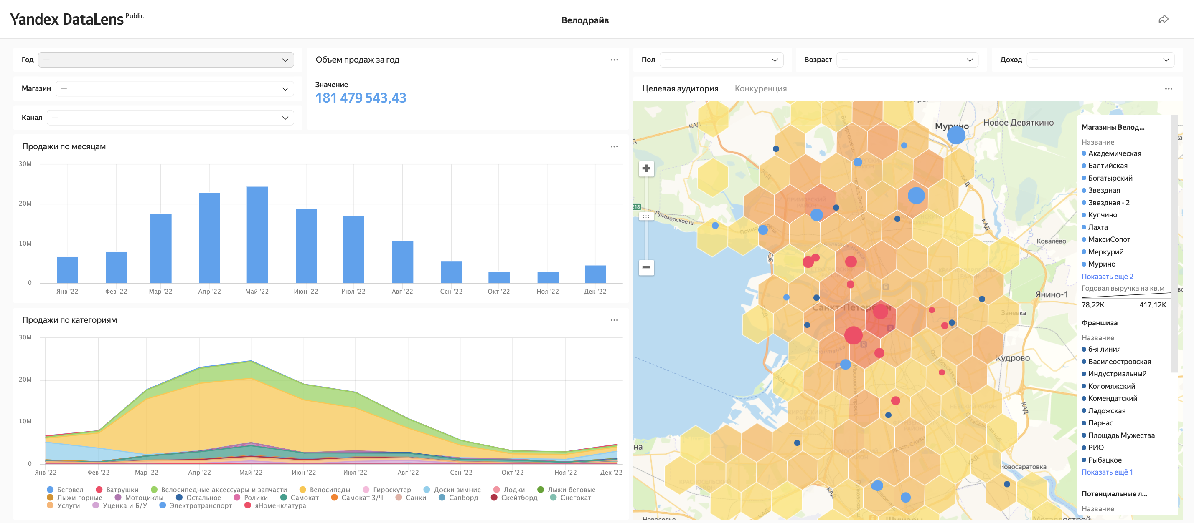

Visualization of Results
*https://datalens.yandex/dyizpxgcxigi3
13
Notes:
Velodrive feels the lack of instuments for data analysis and visualizaion. So, we decided not only to analyze the internal and external data on the company , but also to visualize the core sales data on a dashboard in Datalens. The dash can be found via the QR-code. It reflects the information on the sales levels annually and by month, total and by categories and by stores. On the map one can see the locations of the Velodrive stores , both own and the franchise, the target audience and competition distribution.

Slide 14
Conclusion
Throughout our research the following objectives and tasks have been met:
Problem definition
We defined the company and research problem
We achieved a proper model specification, selected 12 new locations for Velodrive potential new stores and predicted annual sales per 1 sq.m. for them
Model specification
and prediction
Data collection and analysis
We collected and analyzed the data both from the company and from open sources
We calculated business effect for the 5 most suitable preselected locations
Business effect evaluation
Feature importance
We made several iterations of a multiple linear regression model to identify the most important geofactors influencing Velodrive sales
We visualized the results of our analysis with the help of a dashboard on Yandex DataLens
Results
visualization
14
Notes:
Our research and analysis allowed us to come to the following results.

Slide 15
Thank you for attention!
Q&A

